Slide 1
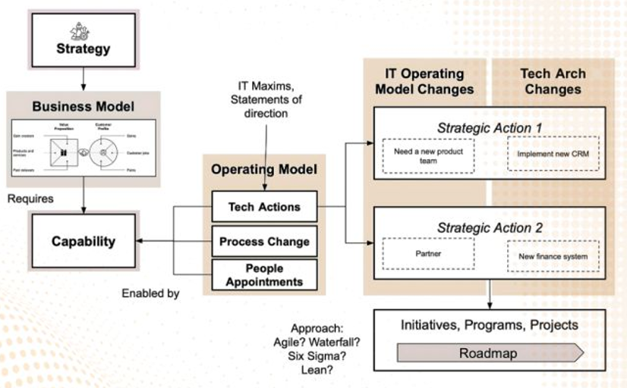
𝗧𝗵𝗲 𝗥𝗼𝗹𝗲 𝗼𝗳 𝗘𝗻𝘁𝗲𝗿𝗽𝗿𝗶𝘀𝗲 𝗔𝗿𝗰𝗵𝗶𝘁𝗲𝗰𝘁𝘂𝗿𝗲 𝗶𝗻 𝗗𝗿𝗶𝘃𝗶𝗻𝗴 𝗗𝗶𝗴𝗶𝘁𝗮𝗹 𝗧𝗿𝗮𝗻𝘀𝗳𝗼𝗿𝗺𝗮𝘁𝗶𝗼𝗻
“𝘼𝙨 𝙩𝙚𝙘𝙝𝙣𝙤𝙡𝙤𝙜𝙮 𝙚𝙫𝙤𝙡𝙫𝙚𝙨, 𝙀𝙣𝙩𝙚𝙧𝙥𝙧𝙞𝙨𝙚 𝘼𝙧𝙘𝙝𝙞𝙩𝙚𝙘𝙩𝙪𝙧𝙚 𝙗𝙚𝙘𝙤𝙢𝙚𝙨 𝙩𝙝𝙚 𝙨𝙩𝙧𝙖𝙩𝙚𝙜𝙞𝙘 𝙙𝙧𝙞𝙫𝙚𝙧 𝙩𝙝𝙖𝙩 𝙚𝙣𝙨𝙪𝙧𝙚𝙨 𝙗𝙪𝙨𝙞𝙣𝙚𝙨𝙨 𝙖𝙜𝙞𝙡𝙞𝙩𝙮, 𝙚𝙛𝙛𝙞𝙘𝙞𝙚𝙣𝙘𝙮, 𝙖𝙣𝙙 𝙖𝙡𝙞𝙜𝙣𝙢𝙚𝙣𝙩 𝙬𝙞𝙩𝙝 𝙢𝙖𝙧𝙠𝙚𝙩 𝙙𝙚𝙢𝙖𝙣𝙙𝙨.” 𝗘𝗻𝘁𝗲𝗿𝗽𝗿𝗶𝘀𝗲 𝗔𝗿𝗰𝗵𝗶𝘁𝗲𝗰𝘁𝘂𝗿𝗲 (𝗘𝗔) has evolved far beyond just being an IT blueprint; it is now the backbone of 𝗱𝗶𝗴𝗶𝘁𝗮𝗹 𝘁𝗿𝗮𝗻𝘀𝗳𝗼𝗿𝗺𝗮𝘁𝗶𝗼𝗻. As businesses face the challenge of aligning technology with ever-changing market needs, EA provides the necessary structure and direction. Here’s why 𝗘𝗔 𝗶𝘀 𝗰𝗿𝗶𝘁𝗶𝗰𝗮𝗹 𝗳𝗼𝗿 𝗱𝗶𝗴𝗶𝘁𝗮𝗹 𝘁𝗿𝗮𝗻𝘀𝗳𝗼𝗿𝗺𝗮𝘁𝗶𝗼𝗻: - 𝗦𝘁𝗿𝗮𝘁𝗲𝗴𝗶𝗰 𝗔𝗹𝗶𝗴𝗻𝗺𝗲𝗻𝘁: EA ensures that technology decisions are aligned with business goals, enabling seamless growth while maintaining operational efficiency. It acts as the bridge between 𝗯𝘂𝘀𝗶𝗻𝗲𝘀𝘀 𝘀𝘁𝗿𝗮𝘁𝗲𝗴𝘆 and 𝗜𝗧 𝗲𝘅𝗲𝗰𝘂𝘁𝗶𝗼𝗻. - 𝗔𝗴𝗶𝗹𝗶𝘁𝘆 & 𝗦𝗰𝗮𝗹𝗮𝗯𝗶𝗹𝗶𝘁𝘆: Modern businesses require flexibility. EA designs architectures that are adaptable to both market demands and emerging technologies, ensuring businesses remain 𝗮𝗴𝗶𝗹𝗲 and 𝗳𝘂𝘁𝘂𝗿𝗲-𝗽𝗿𝗼𝗼𝗳. - 𝗢𝗽𝘁𝗶𝗺𝗶𝘇𝗲𝗱 𝗗𝗲𝗰𝗶𝘀𝗶𝗼𝗻-𝗠𝗮𝗸𝗶𝗻𝗴: With EA, businesses can make informed decisions by gaining visibility into their IT landscape, understanding interdependencies, and optimizing processes across systems. - 𝗘𝗳𝗳𝗶𝗰𝗶𝗲𝗻𝗰𝘆 𝗧𝗵𝗿𝗼𝘂𝗴𝗵 𝗜𝗻𝘁𝗲𝗴𝗿𝗮𝘁𝗶𝗼𝗻: EA promotes the integration of disparate systems, enabling data flow across platforms, driving 𝗼𝗽𝗲𝗿𝗮𝘁𝗶𝗼𝗻𝗮𝗹 𝗲𝗳𝗳𝗶𝗰𝗶𝗲𝗻𝗰𝘆 and 𝗯𝗲𝘁𝘁𝗲𝗿 𝗰𝘂𝘀𝘁𝗼𝗺𝗲𝗿 𝗲𝘅𝗽𝗲𝗿𝗶𝗲𝗻𝗰𝗲𝘀.
Source: Sumeet Goenka
Notes:
At 𝗬𝗔𝗟𝗟𝗢 𝗥𝗲𝘁𝗮𝗶𝗹 | 𝗦𝘁𝗿𝗮𝘁𝗲𝗴𝘆 & 𝗧𝗮𝗹𝗲𝗻𝘁 𝗨𝗻𝗶𝗳𝗶𝗲𝗱, we understand that architecture isn't just about technology; it’s about enabling business transformation. Through our "𝘐𝘛 𝘚𝘵𝘳𝘢𝘵𝘦𝘨𝘺 𝘢𝘯𝘥 𝘈𝘳𝘤𝘩𝘪𝘵𝘦𝘤𝘵𝘶𝘳𝘦 𝘢𝘴 𝘢 𝘚𝘦𝘳𝘷𝘪𝘤𝘦" offering, we empower organizations to not only design innovative IT strategies but also deliver top-tier talent to execute those strategies successfully.

Slide 2
Australia Retail sector
Conceptual:
The models is for analysis, and sector specific pre – engagement purposes.
It provided a level-set and aims to identify the main value creation capabilities & enablement functions.
Value Creation Capabilities
3. Supply Chain & Logistics
[ Inventory Flow, Fulfillment, Logistics ]
1. Customer & Sales Operations
2. Merchandising & Category Management
3. Supply Chain & Logistics
Physical Store Operations
E-Commerce & Digital Sales
Call Centre & Customer Support
Product Selection,
Pricing,
Promotions,
Assortments
Retail Distribution Center Operations
3.1 Distribution Center Operations [WMS]
3.2 Transportation & Logistics
[ TMS ]
3.3 Inventory & Stock Management […]
Retail Transport & Logistic
Warehousing & Storage
Store & Customer Delivery Logistics
Enterprise Inventory Visibility
Inventory & Stock Management
Inventory Replenishment
Last-Mile Fulfillment
RFID & Barcode Tracking
Order Picking & Packing
Reverse Logistics & Returns Processing
Stock Optimization
Returns Processing
Management, Supporting & Enablement Capabilities
Retail Control Centre (DC) Operations
Corporate &
Enterprise Functions
Control Center Operations
[ Distribution Centre ]
(Strategic Planning, Finance, HR, Legal, IT, Sustainability)
Technology & Digital Innovation
IT Infrastructure & Cloud Enablement
Cybersecurity & Compliance
Retail Data & AI Analytics
Enterprise Technology
Technology Platforms
Engineering & Delivery
Notes:
Value Creation Capabilities
Strategy, Delivery, Customer Facing & Operations
Management, Supporting & Enablement Capabilities

Slide 3
Control Center (CC) :
Purpose & Business Plan,
CC
Plan
…
CC
Desired Outcomes
…
Key
Deliverables
…
Measuring Success
CC, Operating Model
Observe for | x
Looking at | y
Take Action by
Succeed When
…
…
…
…

Slide 4
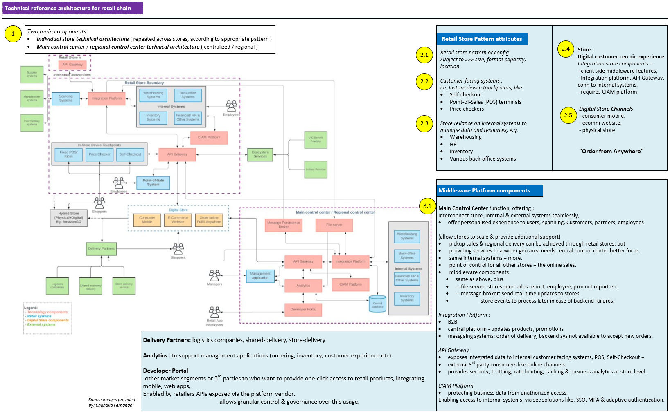

Slide 5
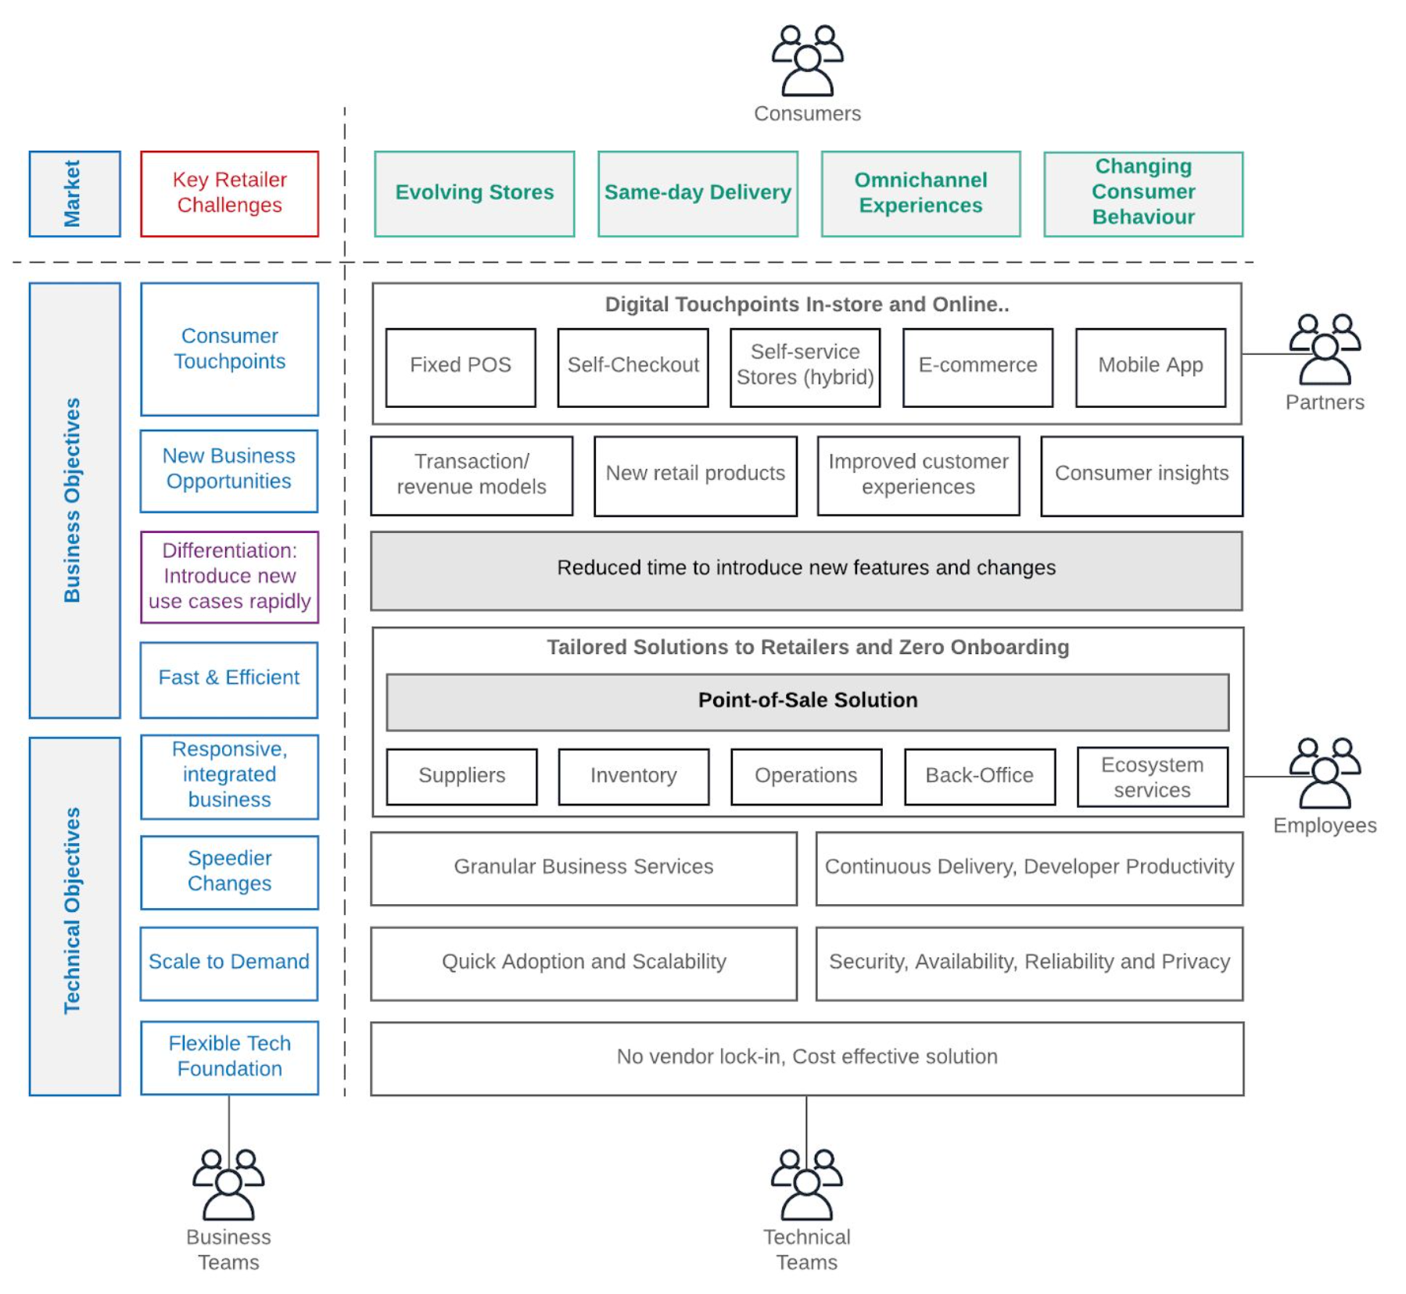
Business Architecture for Retail

Slide 6
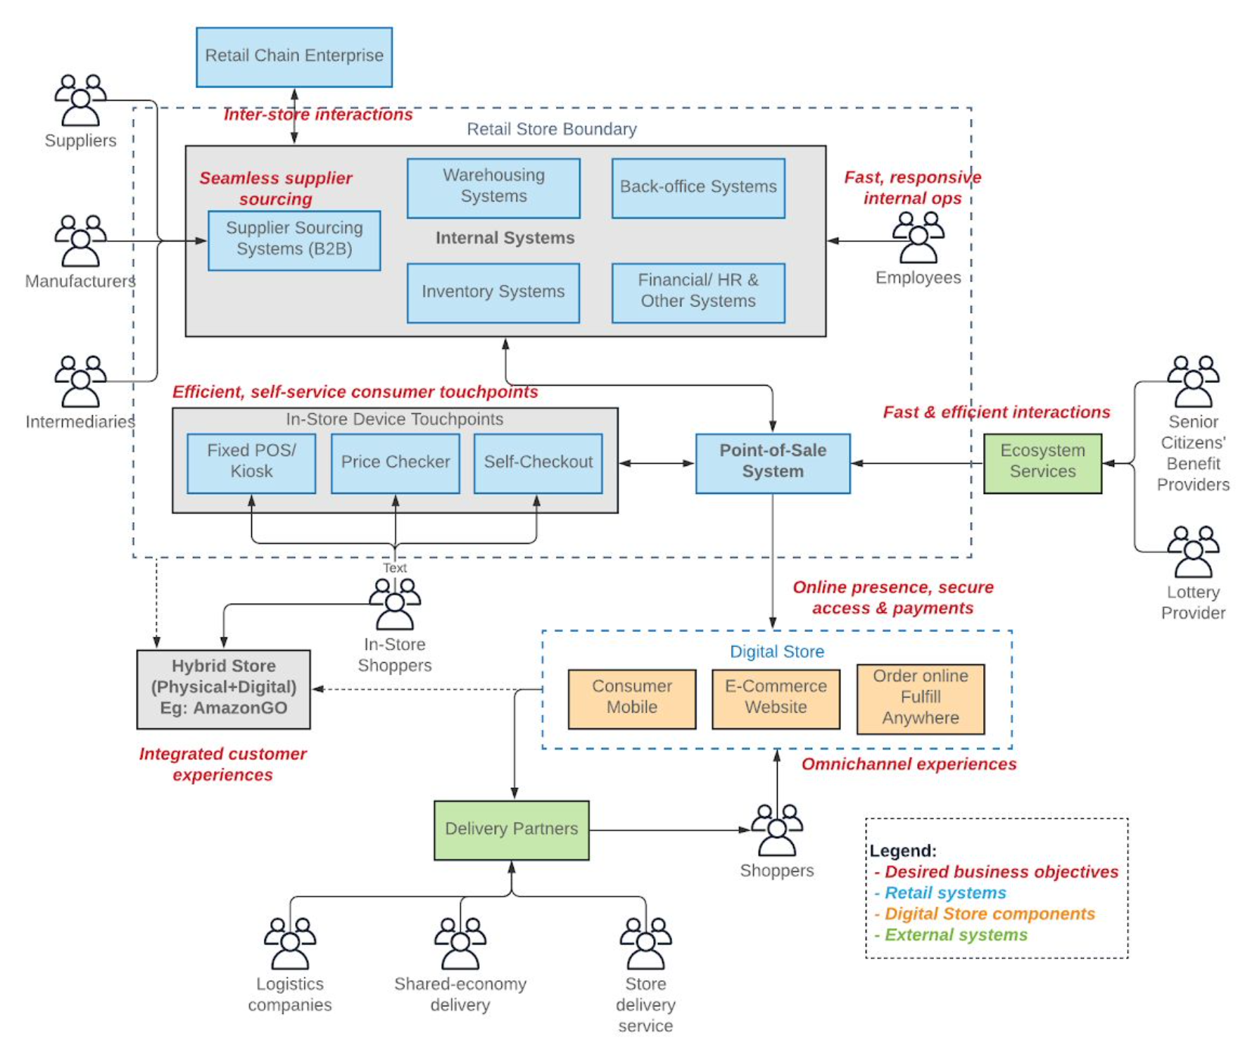
Application Architecture of a Retail Chain
Legend :
The applications/ components that are existing in a particular retailer store are shown in blue.
The external partner systems are shown in green, which may or may not connect to the retail store systems.
The online stores are depicted in orange.
The text in red shows the objectives that the retailer wants to achieve in the future through each component.
The hybrid store in grey shows a potential farfetched objective for the business. It may have its own or a combination of technology/ systems.
Any component in the diagram may or may not be present at a retailer at any given time.

Slide 7
Business and Technical Objectives forming the Business Architecture
High-level Business Objective | Details
Introduce digital consumer touchpoints | To increase checkout convenience. To avoid trips to physical stores.
Introduce new business opportunities | To introduce new revenue models. To introduce new retail products. To offer improved customer experiences. To gather consumer insights.
Achieve differentiation | To be quick to respond to market needs.
Fast, responsive, integrated and efficient operations | To have fast back-office operations. To have an efficient supplier sourcing. To have just-in-time inventory. To work in unison with partners.
Speed of changes | To improve agility and nimbleness
Scale to demand | To meet increasing demand. To enable quick adoption. To scale to increasing demand, and provide reliability, availability, and resiliency.
Flexible technology foundation | No vendor-lock-in. Cost-effective solution.
Future Retail: A Business and Technical ArchitectureDZonehttps://dzone.com › Data Engineering › Data

